Slide 1
GAR
Session 08: Pokemon

Slide 2
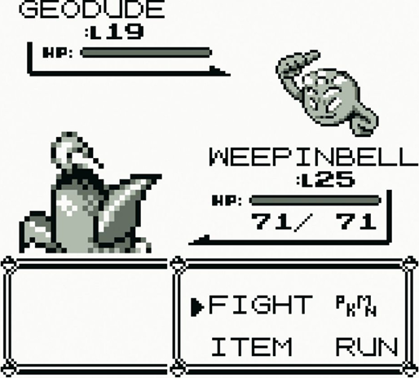
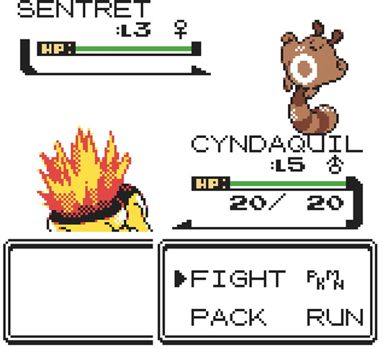
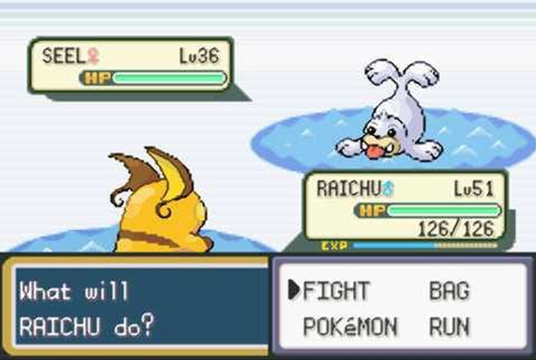
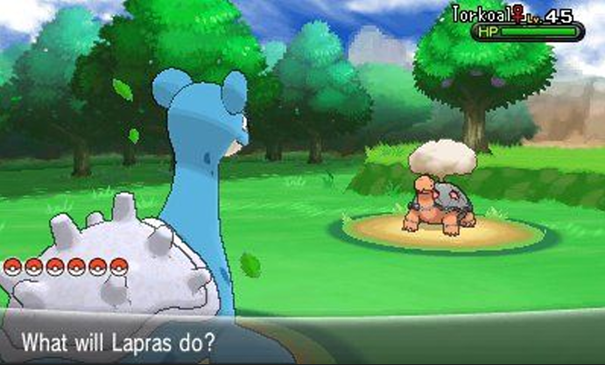
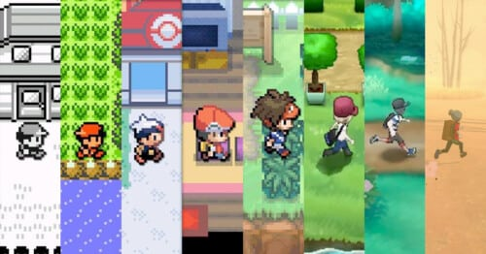
Pokemon

Slide 3
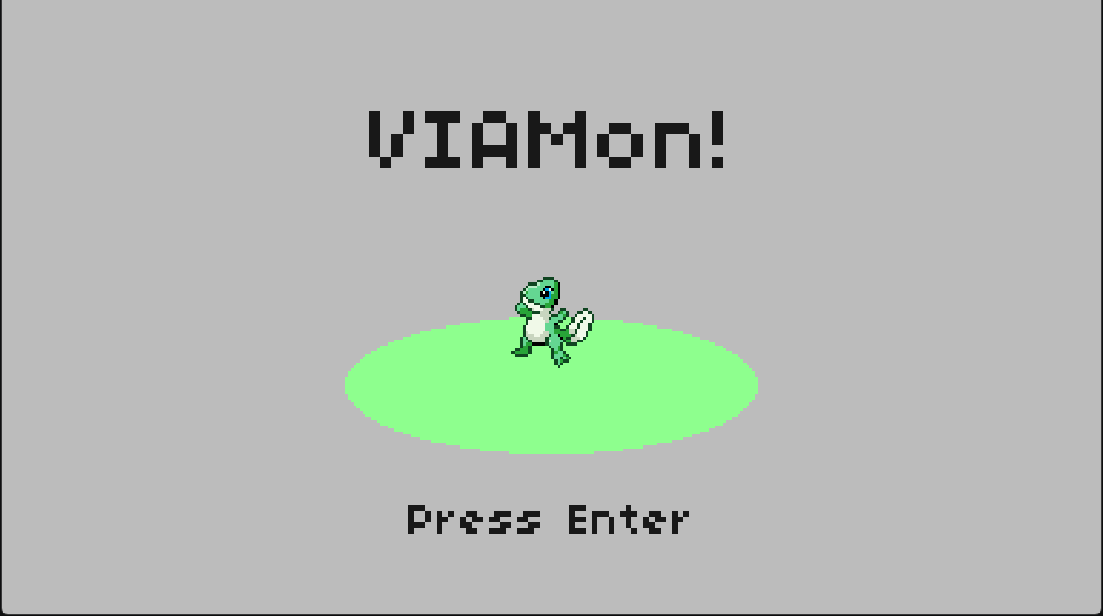
Today’s Goal

Slide 4
Today’s Topics
State Stack
Tweening
GUIs
Turn-Based Systems
RPG Mechanics
Service Locator

Slide 5
Source Code
All Source code for today’s game can be found here:
  https://github.com/Metamate/gmd2-pokemon
Walkthrough in README.md
The game is built up in steps: Pokemon0 → Pokemon4
  Each step is a separate project that adds one concept
  Compare neighbouring steps to see exactly what changed
Pokemon4 is the finished game: explore it, and start the exercises from it

Slide 6
Steps
Pokemon0: the overworld, tile-based movement with tweens
Pokemon1: the state stack (title, fades and dialogue)
Pokemon2: battles (encounters, battle scene and menus; run only)
Pokemon3: turn-based combat and RPG mechanics
Pokemon4: audio through the service locator (the finished game)

Slide 7
Explore the Codebase
Take ~10 minutes to browse the finished game, Pokemon4. Use the README as a guide if you need it.
Clone the repository and build and play the game
  Go through a few encounters in order to level up your mon!
How is the codebase split between the core library and the pokemon-specific project?

Slide 8
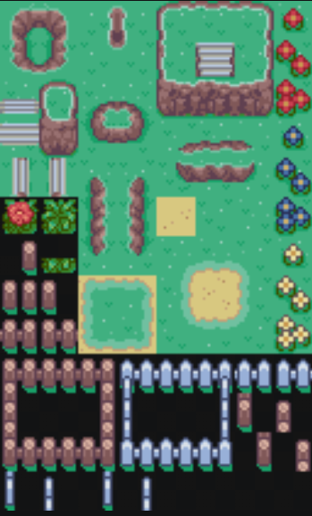
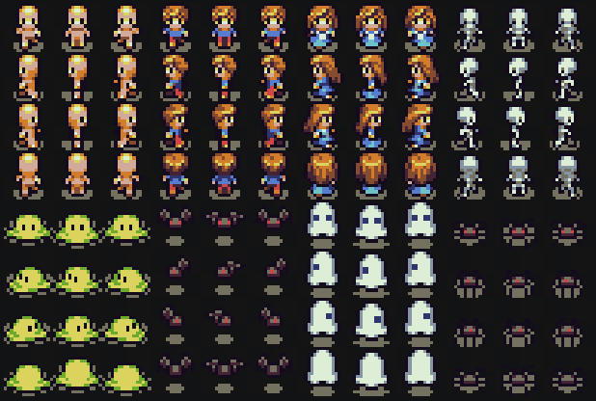

Slide 9
State Stack
Push/Pop states
  Only the top state receives Update
  Though this could be changed if we wanted it to
All states draw, bottom to top
  States underneath stay visible
  Allows us to render multiple states at once
This lets us layer screens on top of each other
  Fade transitions — push a colour overlay on top, animate it, then pop
  Dialogue boxes — message state sits on top of the battle scene
  Battle phases — menu → turn → message, each pushes/pops independently
Example battle stack: PlayState → BattleState → BattleMenuState
Allows us to return back to states as they were when we left them
  Resuming from a battle where we left the field (PlayState)

Slide 10
State Stack Trace
Files: StateStack.cs, BattleState.cs, BattleMenuState.cs, FadeState.cs
A battle just triggered
  List every state on the stack (bottom to top) once BattleMenuState is showing.
Which state gets Update calls? Which states still Draw?
FadeState pushes on top, animates, then pops
  What would break if it swapped the current state instead of push/pop?
Design a PauseState
  where do you push/pop it?

Slide 11

Tweening System
Smoothly changes a value over time (e.g. move a sprite from X=0 to X=100)
Three ways to use it:
  Tween — change a number from A to B over a set time
  After — wait N seconds, then run a method
  Every — repeat a method at a fixed interval (use .Limit to stop after N times)
Chaining: .Add() to animate multiple values at once, .Finish() to run code when done
Callbacks can also push/pop states or change game data
Accessed via Service Locator: Locator.Tweens
Notes:
Such system is often imported as an external library
Safe to create tweens inside callbacks — new ones are queued and start next frame

Slide 12
GUIs
Short for "graphical user interface"
Common widgets and elements include
Panel
  White rectangle with a black border, used as a background for all UI boxes
ProgressBar
  A bar that fills based on current/max (used for HP and EXP)
Textbox
  Wraps text inside a Panel, advances pages when player presses Confirm
Selection / Menu
  A list of options, each with a label and an action to run
  Handles up/down navigation and cursor drawing — adding a new option is one line
And others.. (labels, scrollbars, etc..)

Slide 13
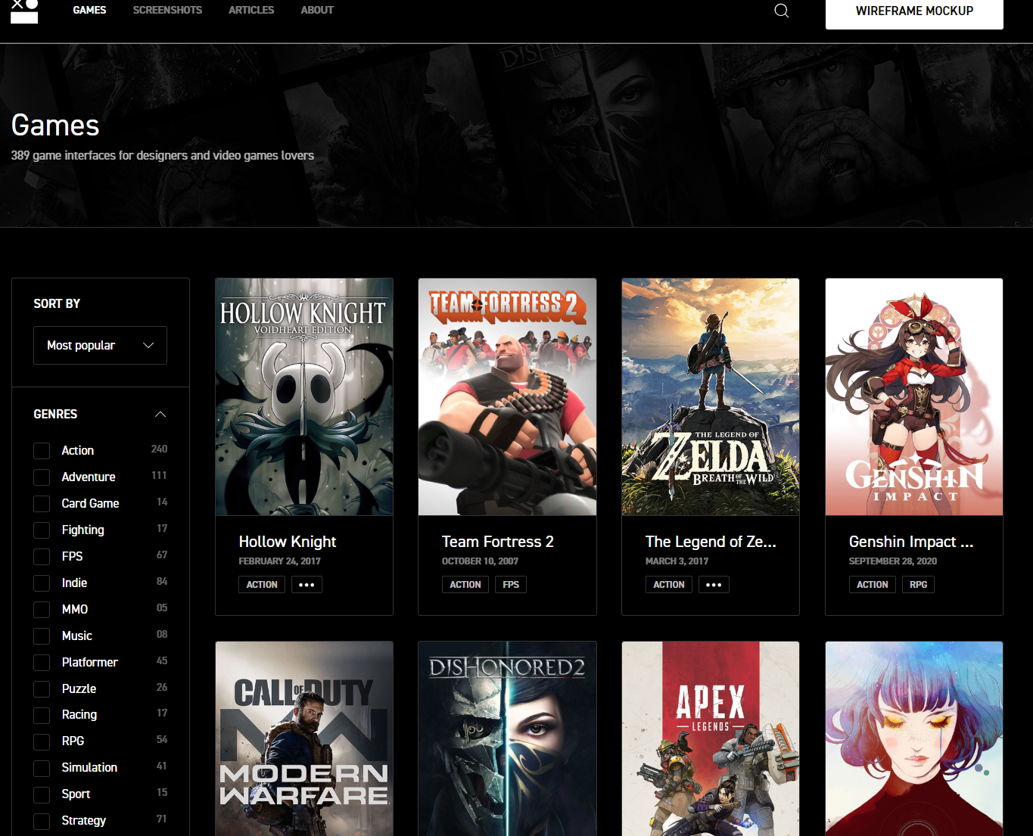
GUIs
interfaceingame.com

Slide 14
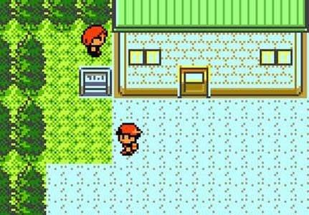
Tile-Based Movement
Two sets of coordinates per entity
  MapX/MapY (int) — which tile the entity is on (used for game logic)
  X/Y (float) — the pixel position on screen (smoothly tweened between tiles)
EntityWalkState — handles one step between tiles
  Snaps MapX/MapY to the new tile instantly, then tweens X/Y to catch up
PlayerWalkState — if a direction key is still held, starts another step; otherwise goes Idle

Slide 15
Overworld & Random Encounters
Level (Pokemon4/World/Level.cs)
  Two TileMap layers: base terrain + tall grass
  Base terrain tile pattern is randomly generated
Random encounter check
  Runs each time the player ends a step in tall grass tiles
  A random roll decides if a battle starts (probability set in GameSettings)
Transition to battle:
  Stop field music → start battle music
  Fade to white → push BattleState → fade back in
  All done with push/pop on the state stack — no special-case code

Slide 16
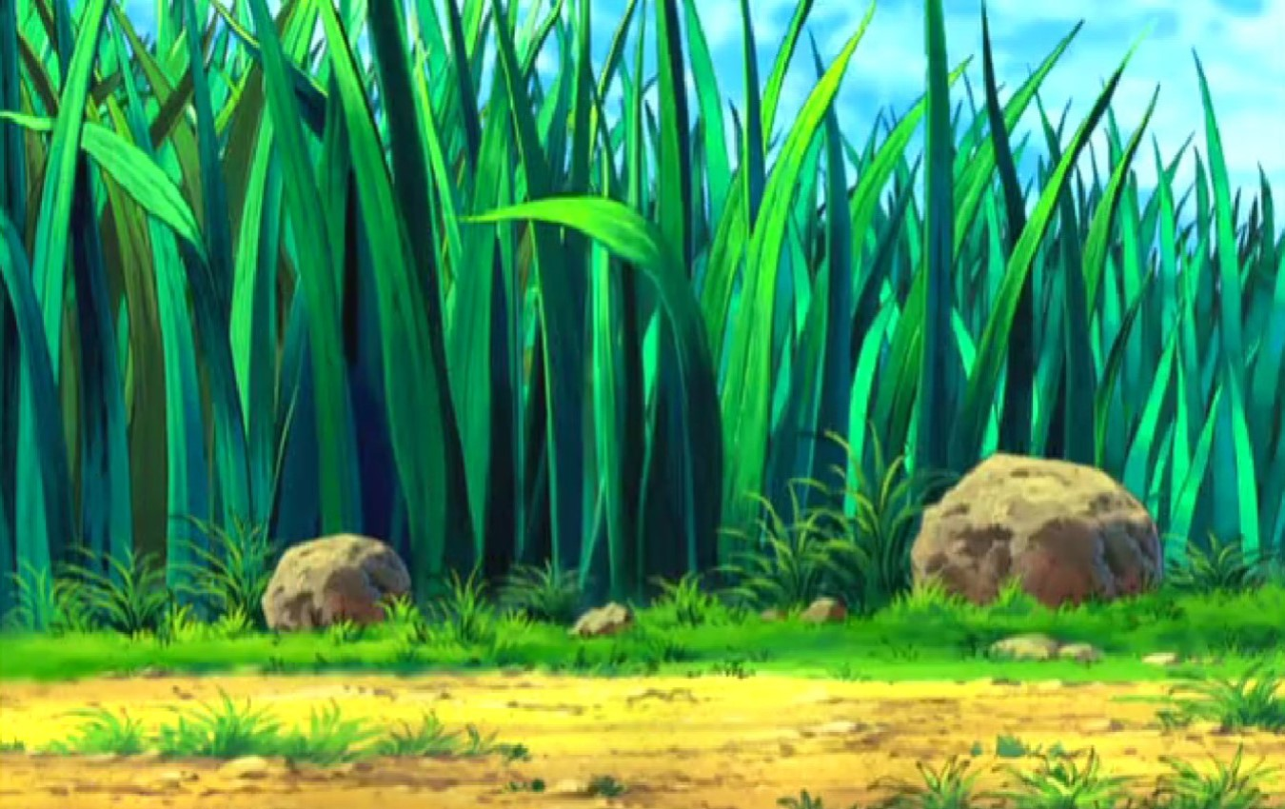
Overworld Encounters
How does a battle start?
  Find out where in the code the game transitions from PlayState to BattleState
  What other states are involved in the StateStack at this moment?
  What happens when a battle ends?

Slide 17
The Battle System
BattleState
  Draws the battle scene: two sprites, HP/EXP bars, bottom panel
  Opening animation: both sprites slide in from opposite edges
BattleMenuState
  Shows the Fight / Run menu
TakeTurnState
  Runs one full battle round
  Faster Pokemon (higher Speed) attacks first
  Attack sequence: pause → lunge forward → hit sound → blink → HP bar drops
  Each step is a tween that triggers the next one when it finishes — no if/else chain
Flow: Menu → TakeTurn → (both alive?) → back to Menu, or → fade out

Slide 18
RPG Mechanics
PokemonSpecies
  Defines a species: name, base stats, growth rates, sprite paths
Mon
  One actual Pokemon in the game
  Each level, every stat rolls a 6-sided die 3 times — higher growth rate = more likely to gain a point
Damage
  (Attack * move.BasePower / 10) - defender.Defense (minimum 1)
Experience:
  Beating a Pokemon gives EXP based on its growth rates × level
  LevelUp() returns how much each stat increased so the UI can show it
Party
  Holds your team of Mons; Party.Current is the one in battle

Slide 19
Monster Battles
What is the flow of a single turn in battle?
  From choosing an action to showing the result
How are attacks and moves represented in the code?
  Where is damage calculated?
How does the game decide when a battle ends?
  What happens right after victory or defeat?
How are core RPG stats handled for a monster?
  HP, IV, level, attack, experience, etc..
What causes a monster to gain experience and level up
  How are stat increases applied?
How is a party of monsters modeled?
  How does the battle system use that party data?

Slide 20
Definition Files
Game data lives in JSON files, game logic lives in C#
Pokemon_definitions.json
  Species name, base stats, growth rates, sprite paths
  Loaded into C# objects using System.Text.Json
Entity_animations.json
  Animation name, which spritesheet frames to play, timing
The C# classes that receive this data use record types
  Small classes that just hold data
Adding a new Pokemon means editing a JSON file, not rewriting C# code
Notes:
XML -> JSON

Slide 21

Data-Driven Definitions
Start from Pokemon4, the finished game
Add a new species to pokemon_definitions.json
  Make it a glass cannon (high attack, low defense). Run the game and fight it
Add a "type" field (Fire/Water/Grass) to the JSON and PokemonSpecies.cs
  Verify the data loads correctly
  Make Mon attacks take defender type into account (super effective vs not very effective)
Save the player’s party and position to a JSON file
  Load it on startup if it exists

Slide 22
Service Locator
Many classes need shared services (audio, tweens, assets)
  How do they find them?
Solution: Locator.cs — a static class that holds references to shared services
  Any class can call Locator.Audio.PlayHit() or Locator.Tweens.Tween(...)
  Services are registered once at startup: Locator.Provide(audioInstance)
Null object: before the real service is registered, a "do-nothing" version stands in
  NullAudio implements IAudio with empty methods — no null checks needed
MonoGame has Game.Services
  Just a generic dictionary
  E.g. Services.AddService<IAudio>(audio) and Services.GetService<IAudio>()
  … But not needed, as we roll our own
Notes:
Why not a singleton? This pattern lets you swap the real implementation for a fake one (useful for testing or if audio fails to load)

Slide 23
Some Missing Features
Detailed Level-Up Screen
Monster Catching
Field Menu For Browsing Pokemon
Item Inventory
Different Abilities
Other Trainers to Fight
Monster Evolution
Towns, Routes, and Other Levels
Breeding
Day/Night Cycle
Types (Fire/Water/Grass)

Slide 24
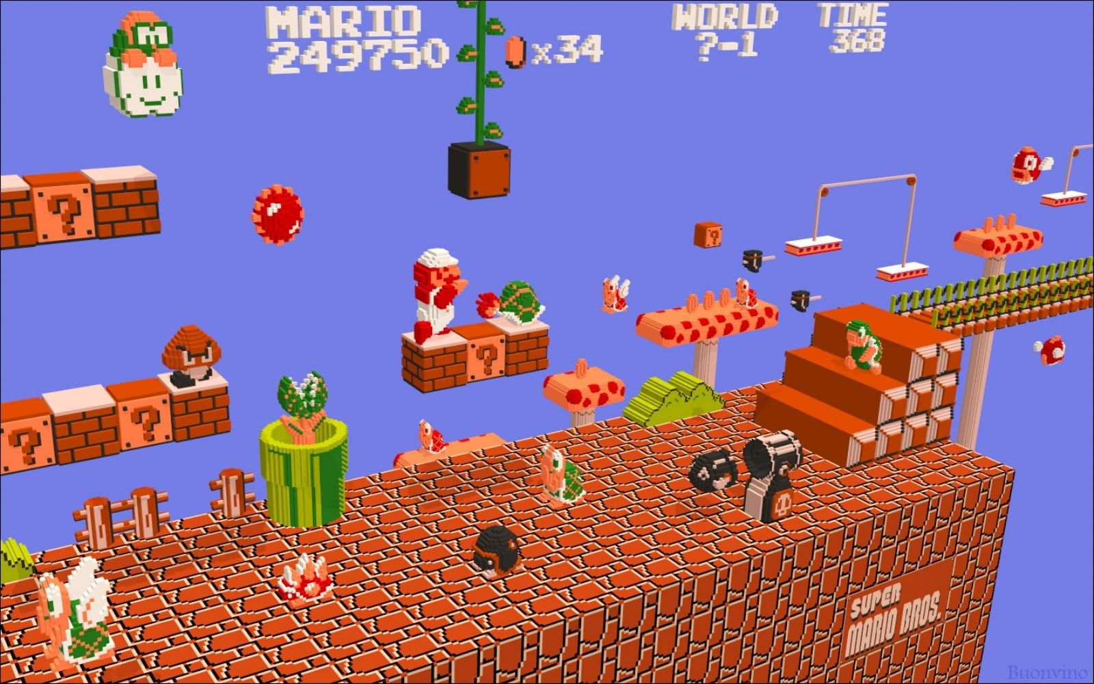
Project Status
Short status meeting with each group

